Slide 1
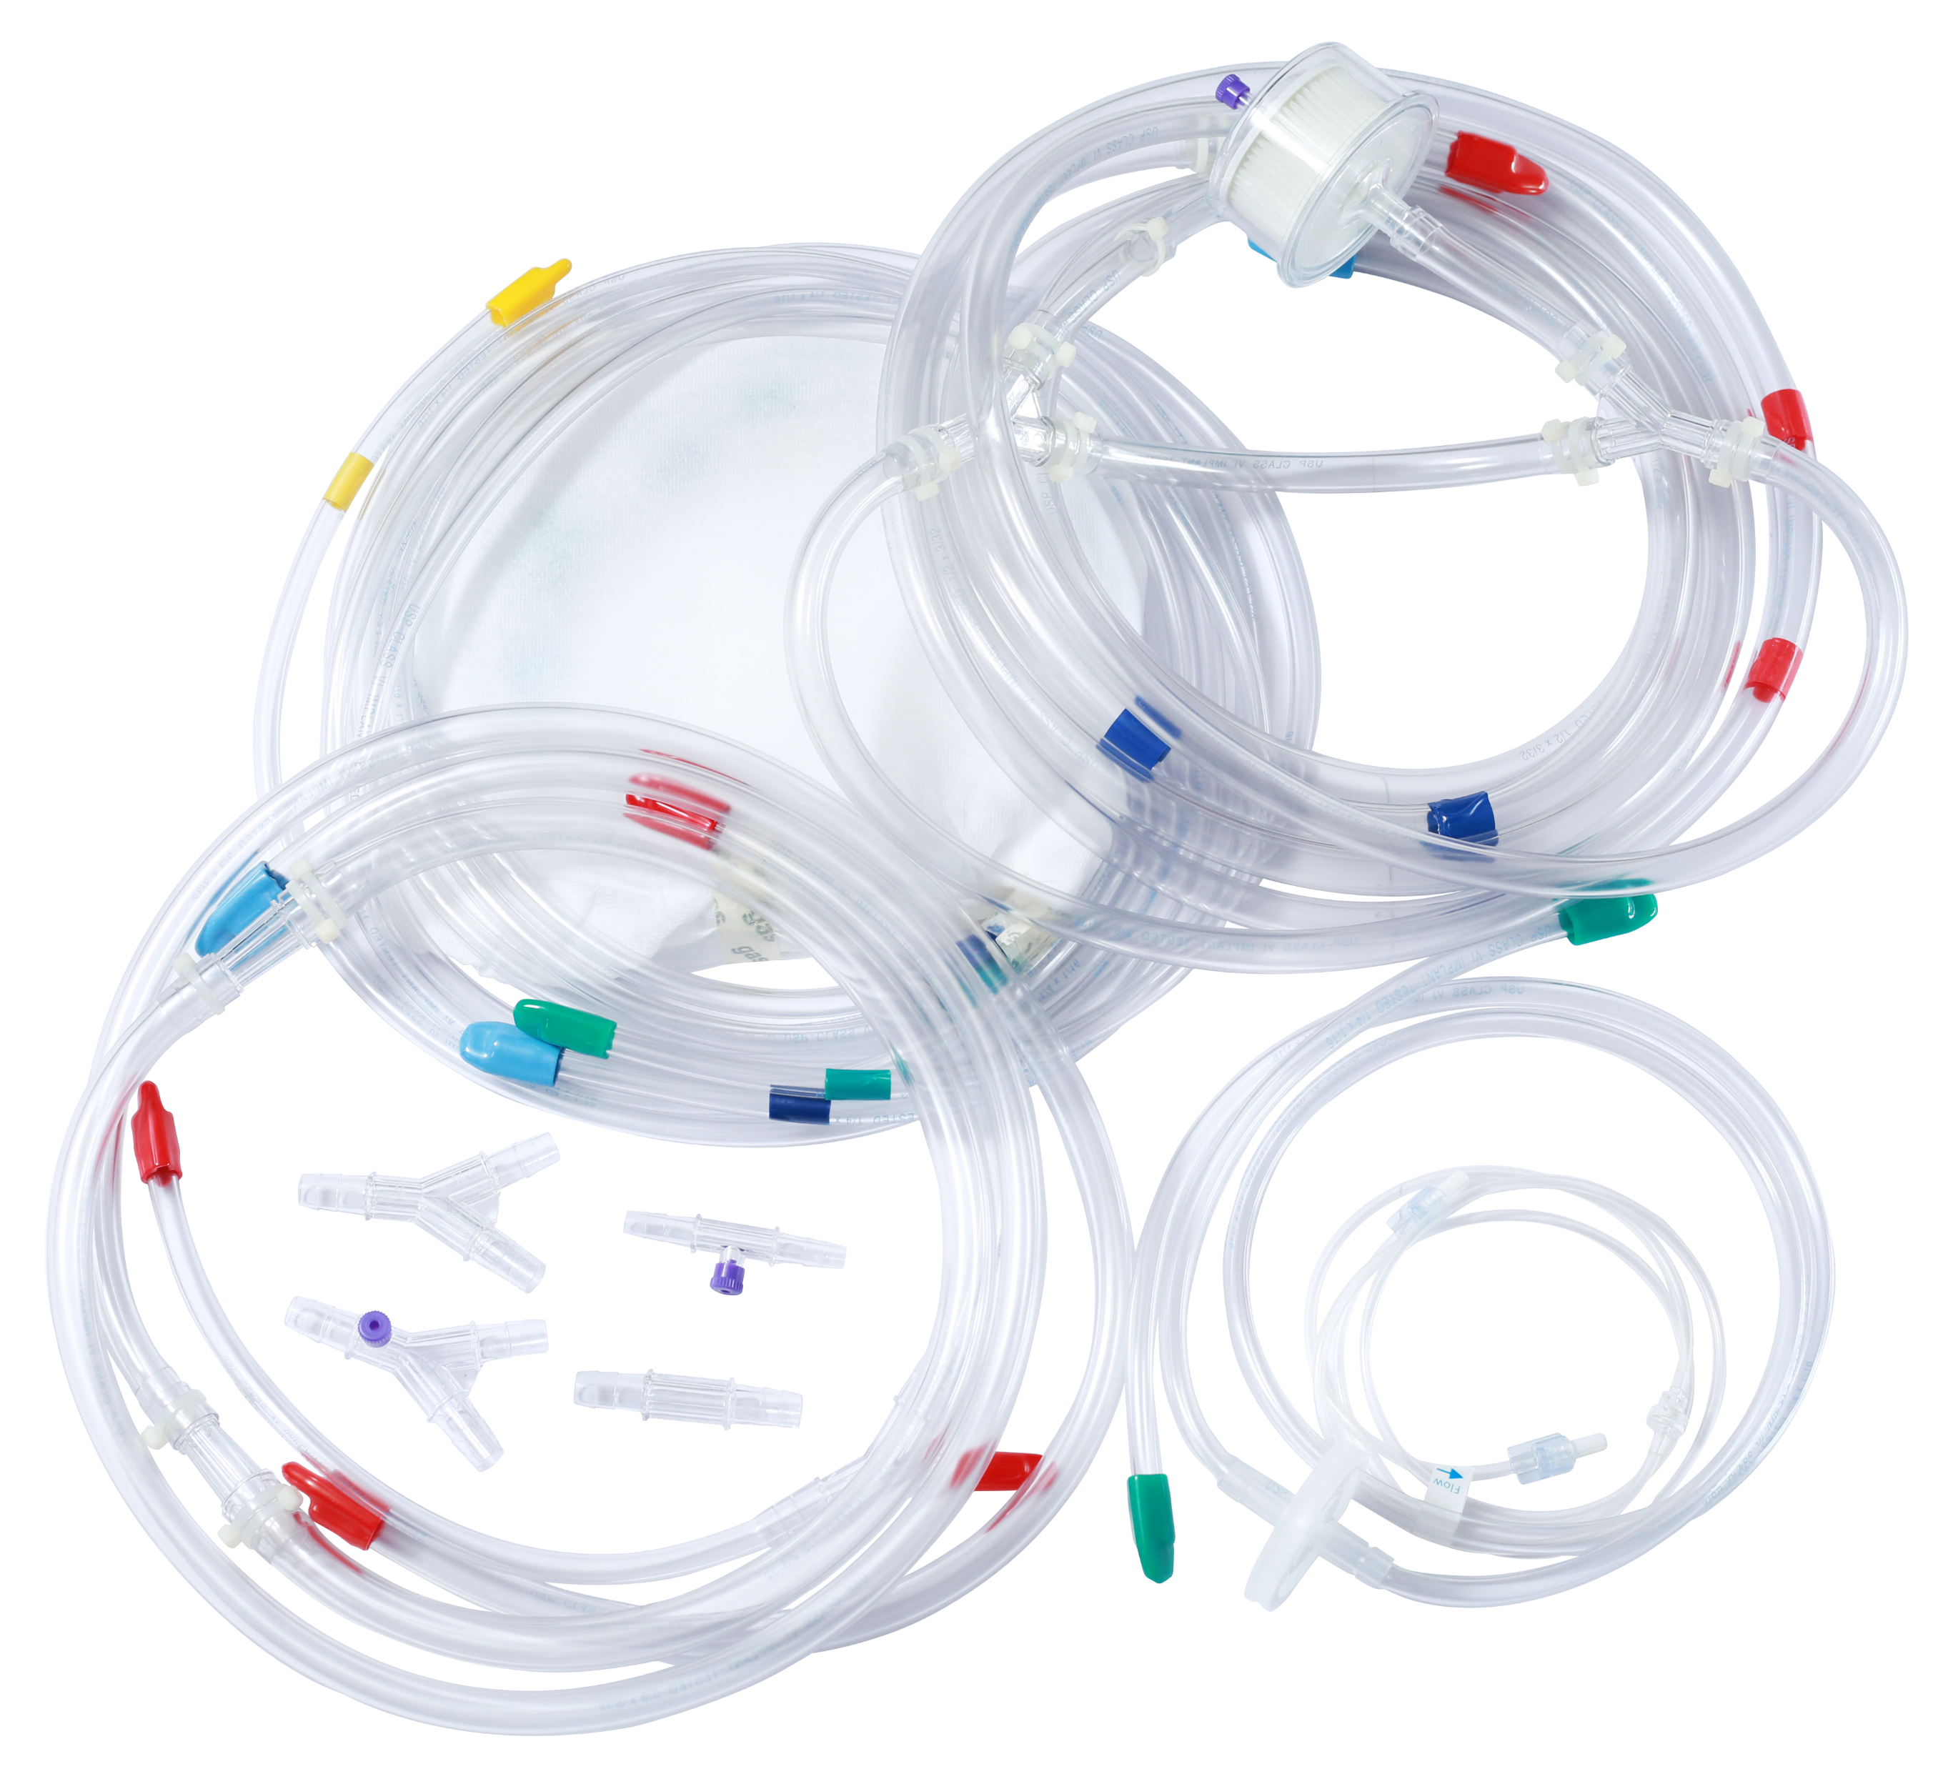
HEART LUNG PACK/ HEART LUNG PACK WITH COATED TUBING
Class VI implant tested tubing
Non-kinking, transparent, clear tubing
Options of clear or colour stripes Red/ Blue/ Green/ Yellow, DEHP free
High quality Heart Lung packs can be customized for individual requirement for various cardiac surgical procedures for Adult, Pediatric and Infant.
Options of components include: Gas line filter, Arterial filter, SpO₂ monitoring, Tubing organizer, Sucker, LV Vents
UHLP-1017 : Standard Std. Pack with Arterial Filter
Contact for non obligatory drawings/ quotes/samples.
Additional components can be added per requirements.

Slide 2
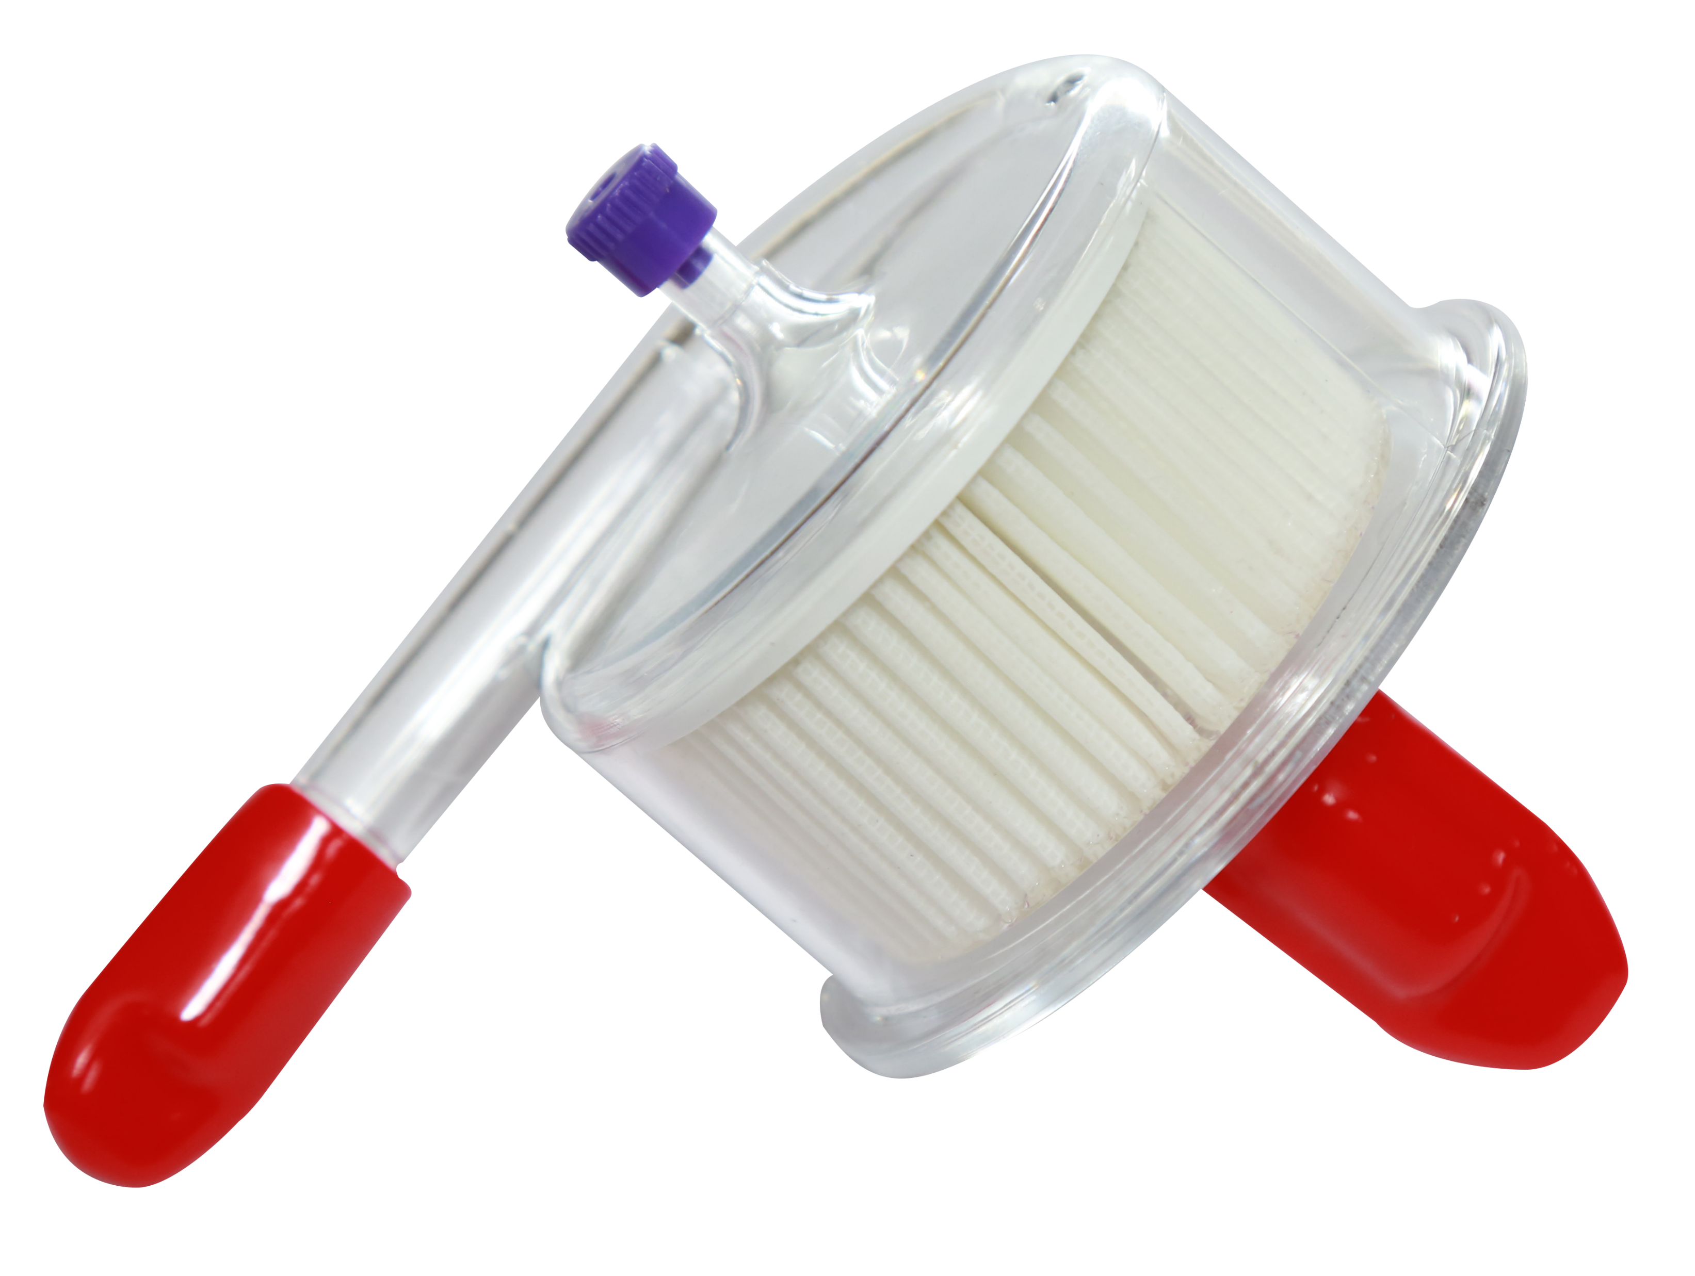
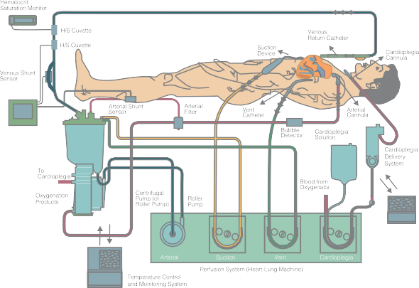
ARTERIAL FILTER
Specifications: Adult Filter
40 m Polyster screen filter
Max. blood flow 7 L/min.
Priming volume of 160 ml.
Excellent air handling
Excellent visibility & easy priming.
Specifications: Pead. Filter
40 m Polyster screen filter
Max. blood flow 3 L/min.
Priming volume of 100 ml.
Excellent air handling
Excellent visibility & easy priming
Specifications: Infant Filter
40 m Polyster screen filter
Max. blood flow 1.5 L/min.
Priming volume of 30 ml.
Excellent air handling
Excellent visibility & easy priming.

Slide 3
ARTERIAL FILTER
Ordering Information:
UAF-A7 : Adult arterial filter with connections 3/8 inlet & outlet
UAF-A7L : Arterial filter with connections 3/8 inlet & outlet with bypass loop
UAF-A7LP : Adult arterial filter with connections 3/8 inlet & outlet with bypass loop & purge line
UAF-P3 : Peadiatric UAF-A7LP : arterial filter with connections 3/8 inlet & outlet
UAF-P3L : Peadiatric arterial filter with connections 3/8 inlet & outlet with bypass loop
UAF-P3LP : Peadiatric arterial filter with connections 3/8 inlet & outlet with bypass loop & purge line
UAF-1.5 : Infant arterial filter with connections ¼ inlet & outlet
UAF-1.5L : Infant arterial filter with connections ¼ inlet & outlet with bypass loop
UAF-1.5LP : Infant arterial filter with connections ¼ inlet & outlet with bypass loop & purge line

Slide 4
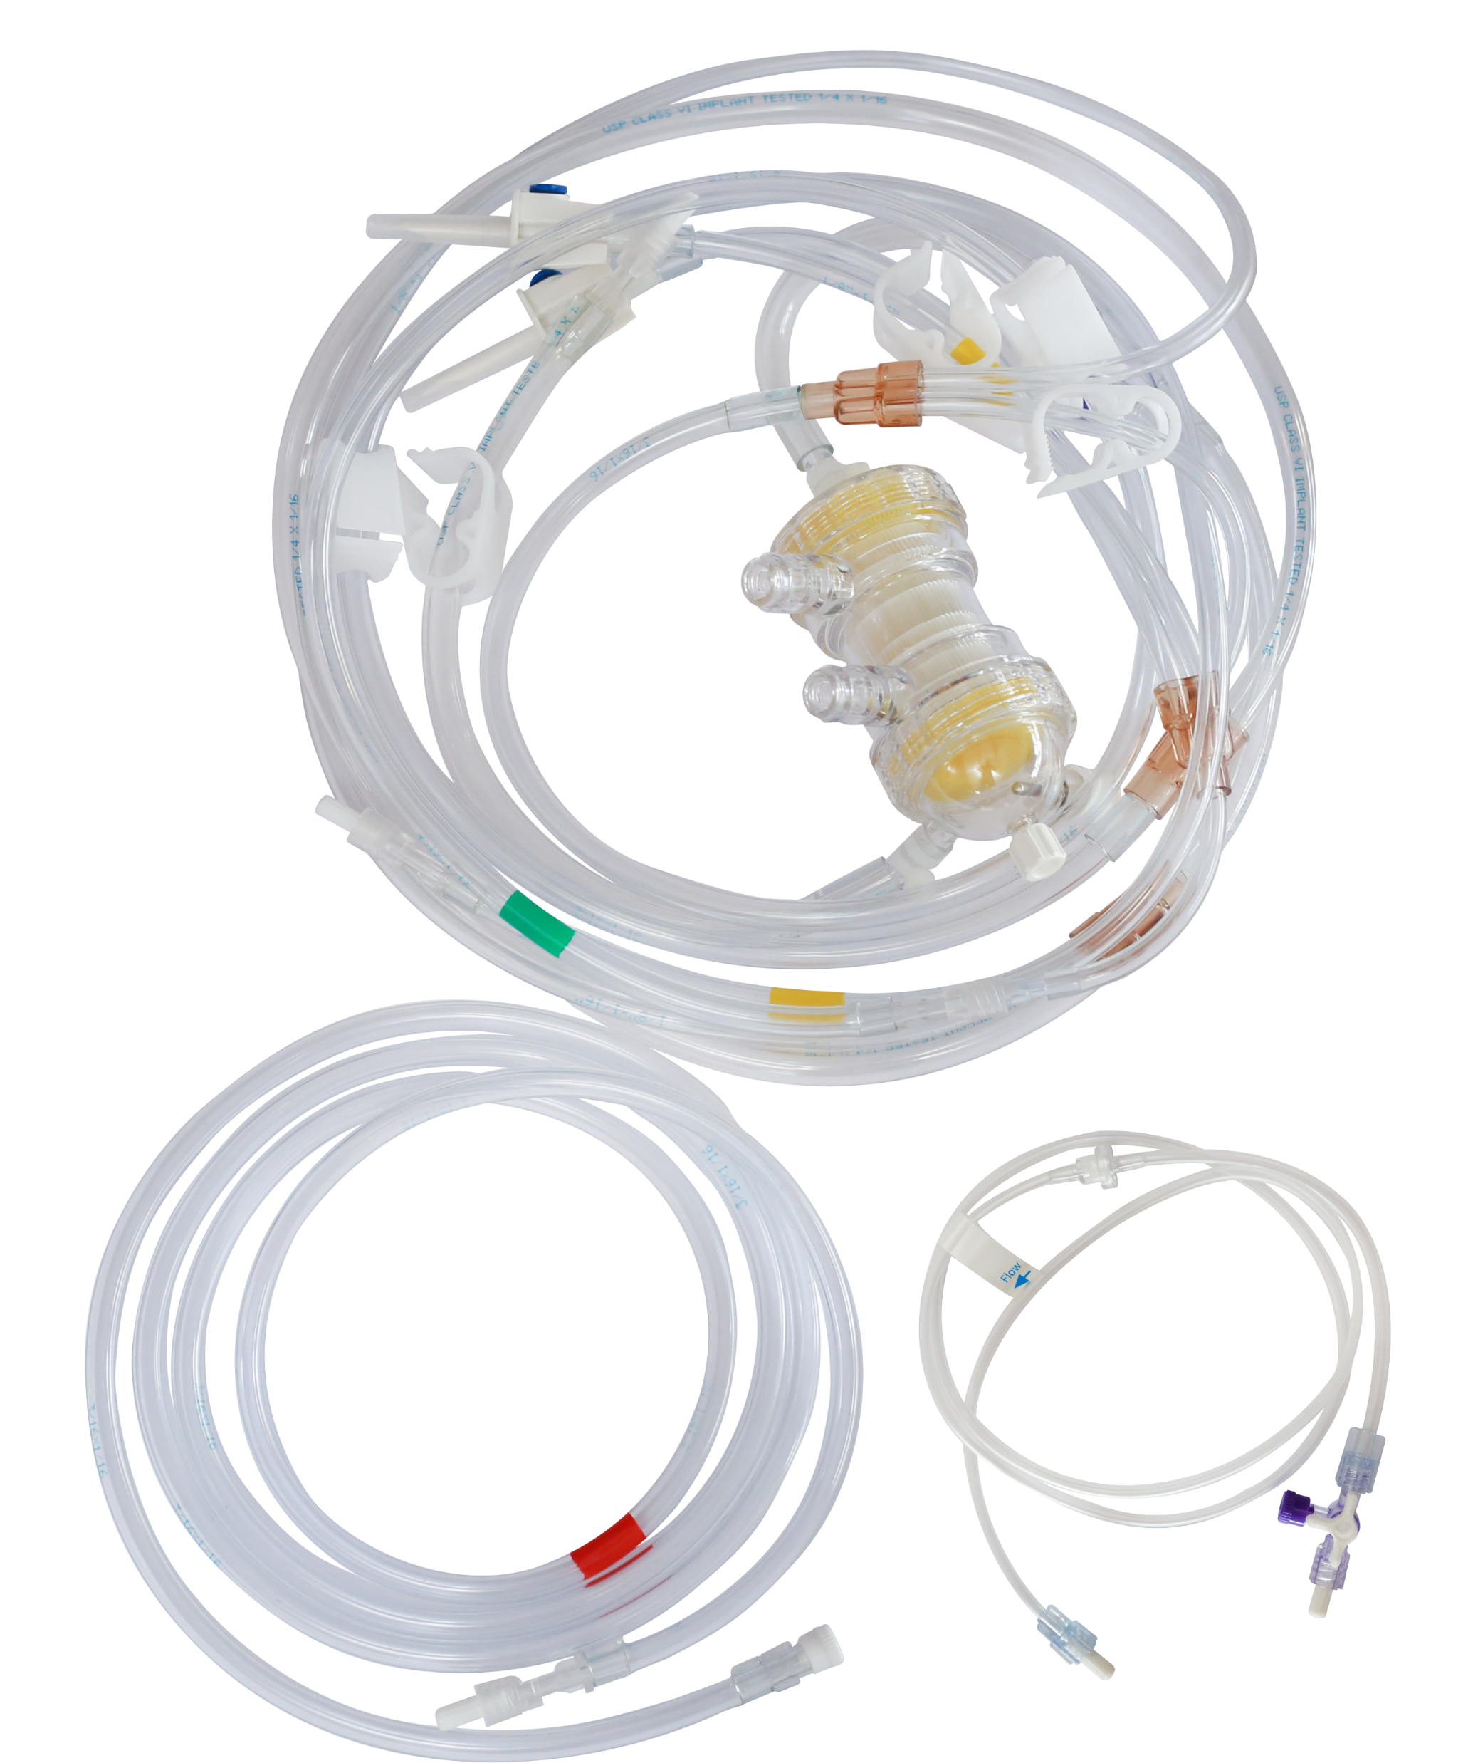
CARDIOPLEGIA DELIVERY SET
Heat Exchanger Pleatal type
Class VI implant tested tubing
Integrated Heat exchanger with bubble trap
Priming volume 35 ml
High Cooling efficiency
Easy set-up & priming
Non-toxic & pyrogen free
Blood inlet-outlet connection -1/4”
Built in bridge for choice of 100% Blood or 100% Cardioplegia solution delivery
Heat Exchanger Coil
Delnido Model Available

Slide 5
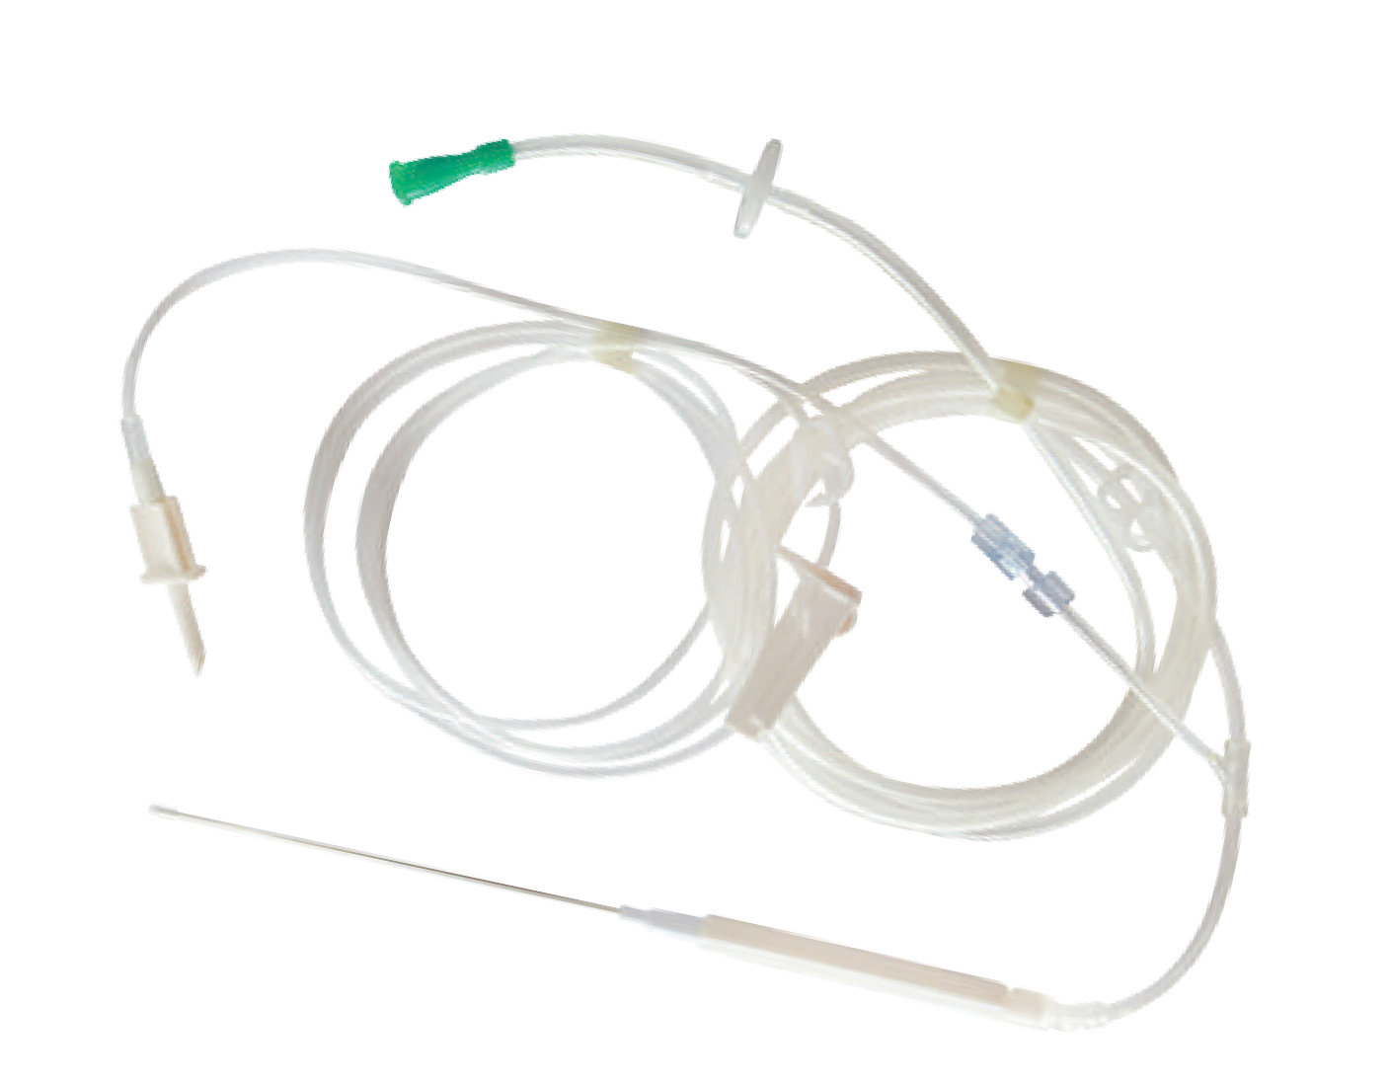
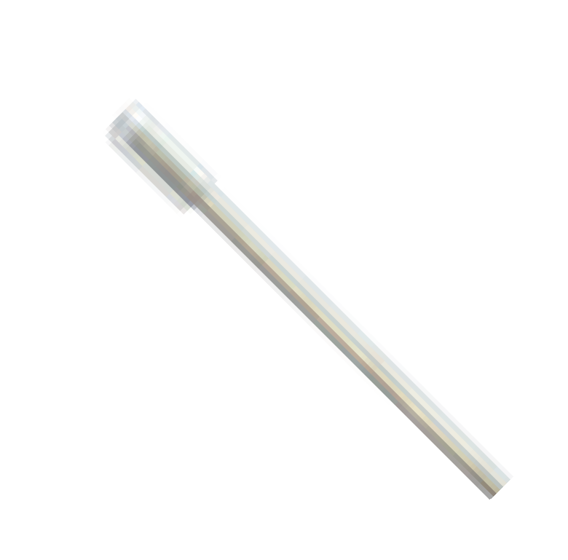
MISTER/BLOWER
Advanced fluid/gas mixing technology for controlled delivery of CO₂ and saline during off-pump
Surgery
Consistent & predictable blood clearing mist
Improved visibility at anastomosis and surgical site
Class VI implant tested tubing, DEHP Free
Only blower cannula without tubing and set available
Ordering Information:
Blower with tubings and fluid set

Slide 6
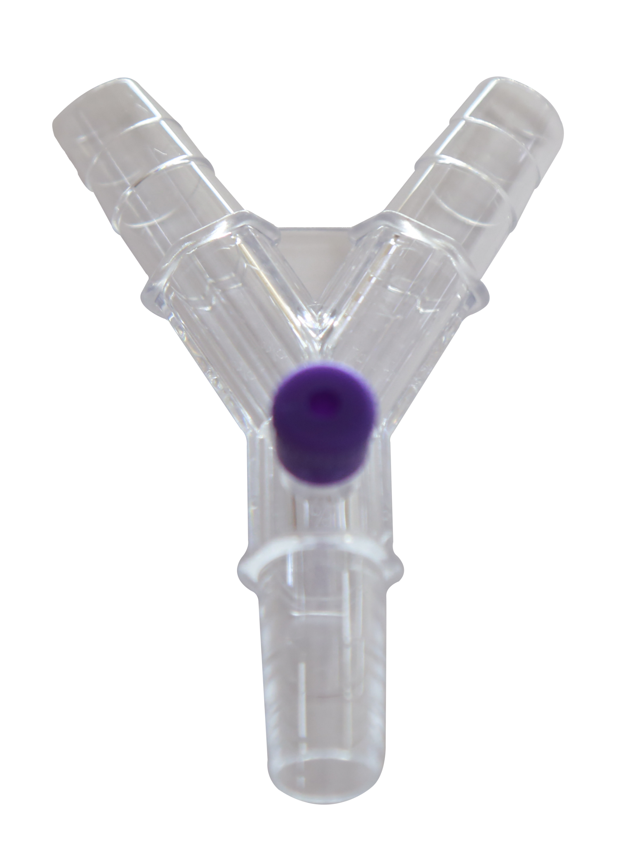
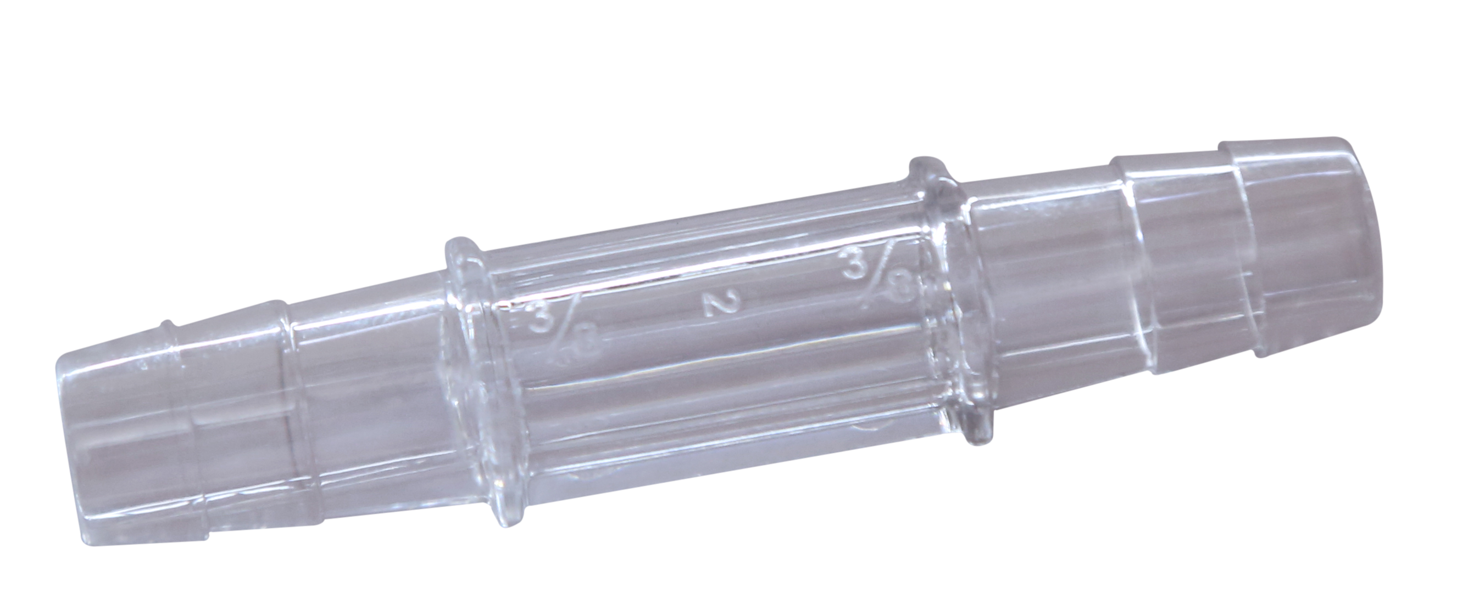
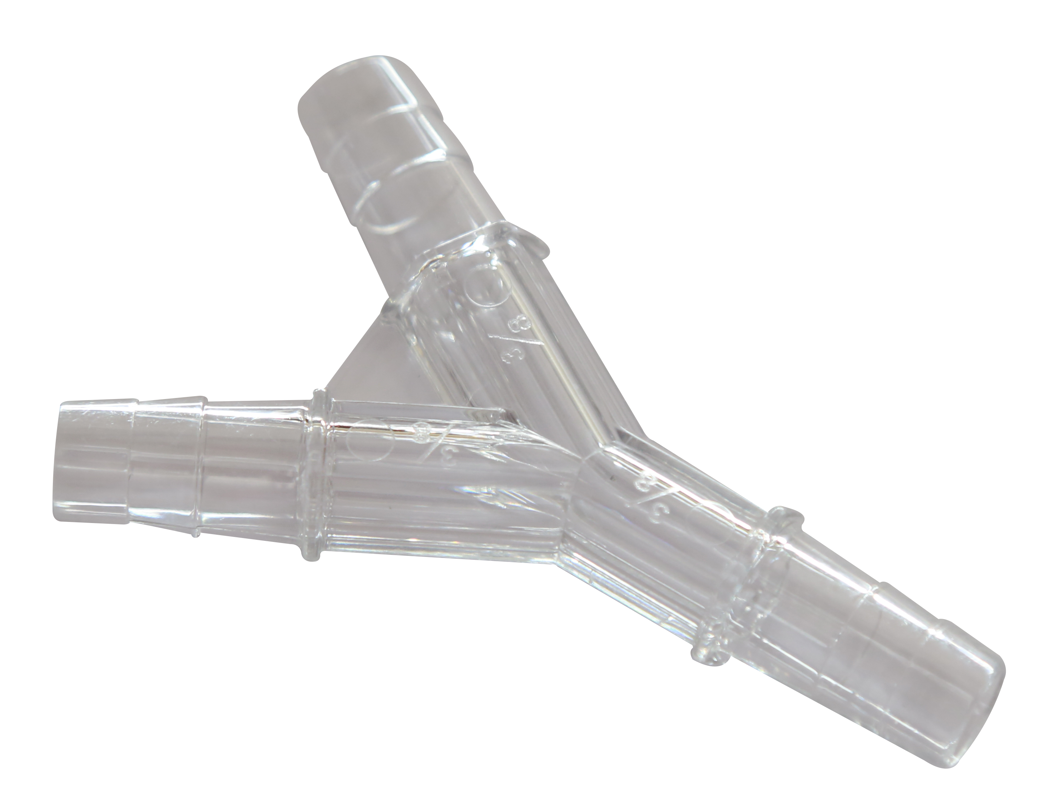
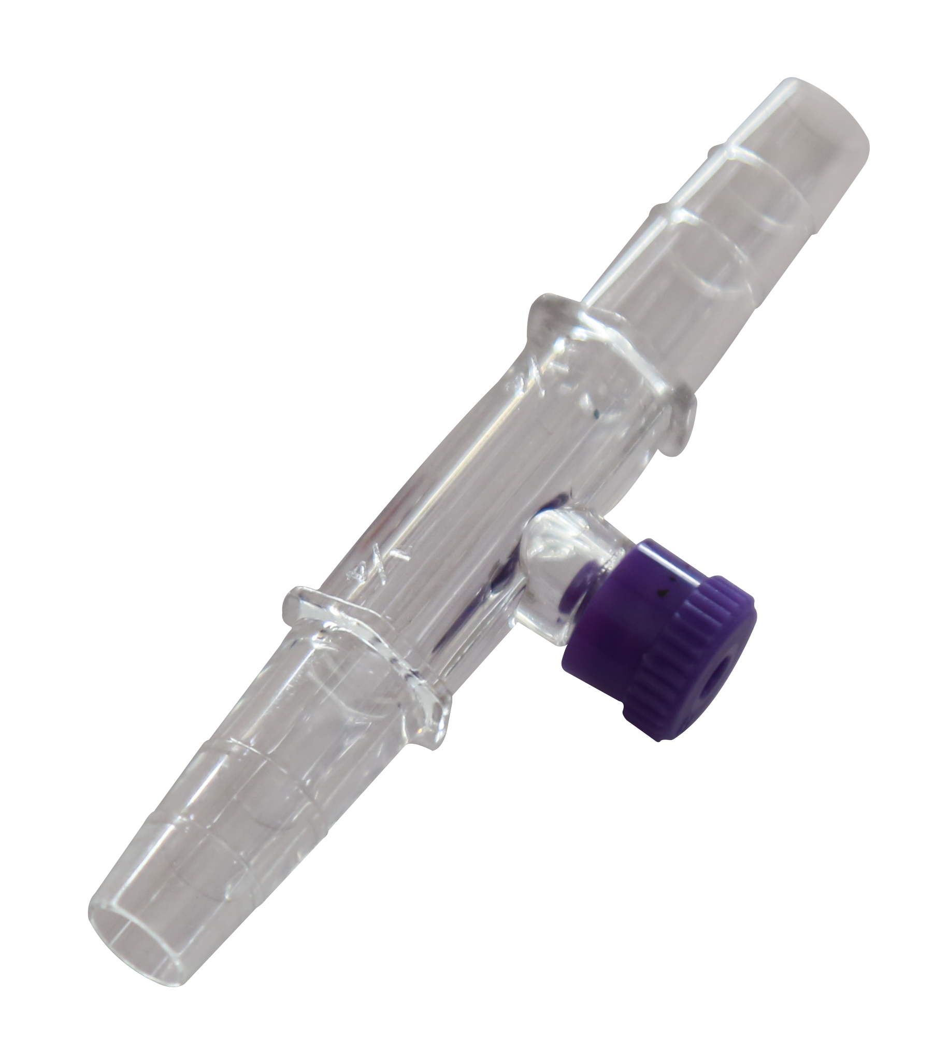
PERFUSION ACCESSORIES
Y Connector
Y Connector with Luer Lock
Straight Connector
Straight Connector with male Luer
Straight Connector with Luer Lock

Slide 7
PERFUSION ACCESSORIES

Slide 8
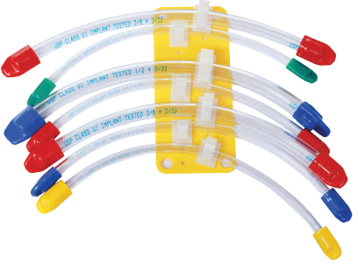
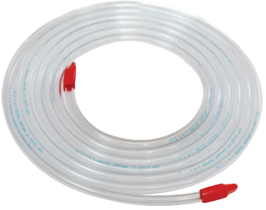
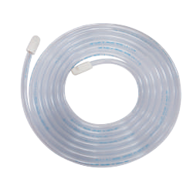
PERFUSION ACCESSORIES
Tubing Organiser
Code: UTO- 01
Perfusion Tubing
Tubing |  | Wall Thickness | Length
1/8 | x | 1/16 | 10Ft
1/4 | x | 1/16 | 12Ft
3/8 | x | 3/32 | 10Ft
3/16 | x | 1/16 | 10Ft
3/16 | x | 3/64 | 10Ft
1/2 | x | 3/32 | 10Ft

Slide 9
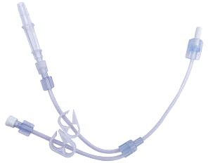
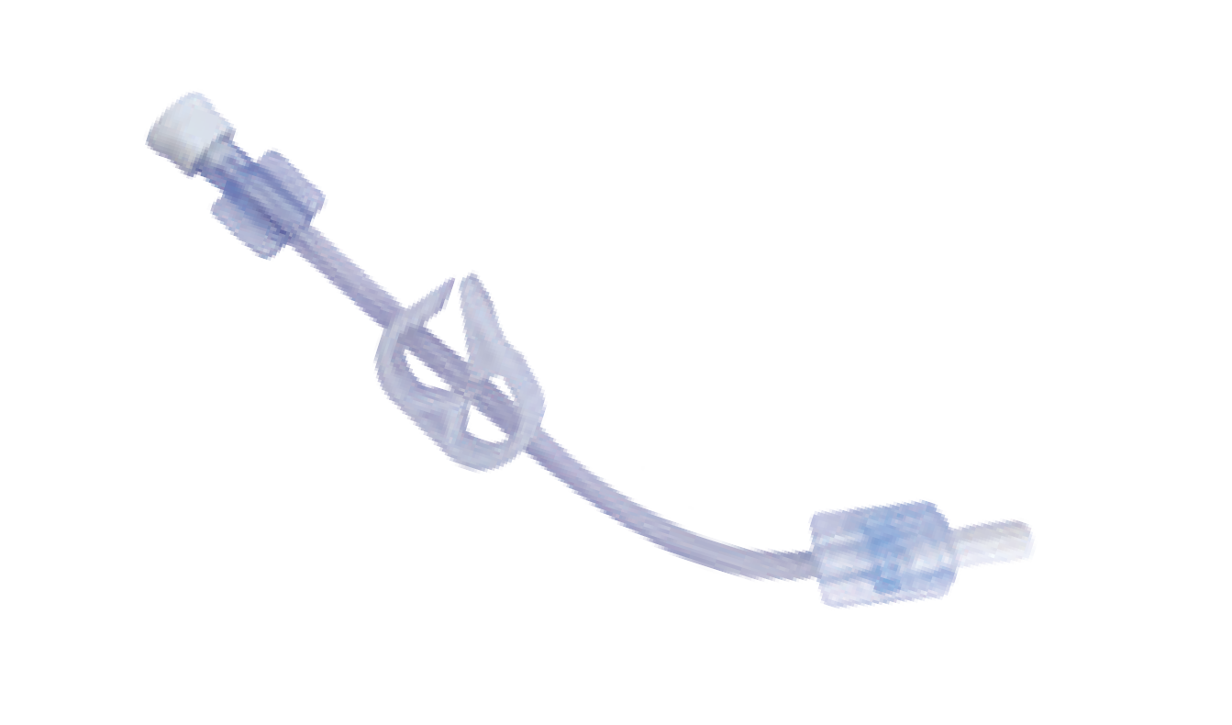
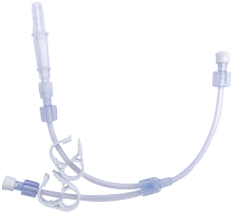
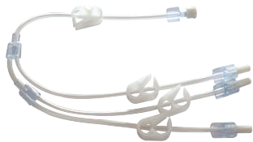
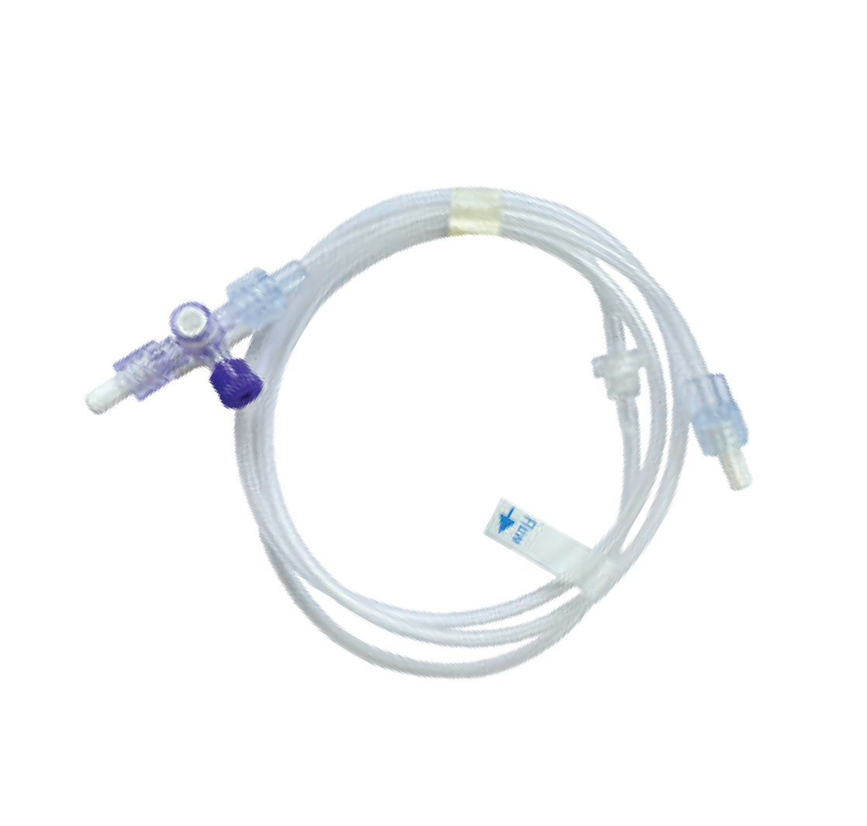
PERFUSION ACCESSORIES
Cardioplegia Perfusion Adapters
Code : UCA-01
Code : UCA-02A
Code : UCA-02B
Code : UCA-03
Purge Line UPL-01

Slide 10
ARTERIAL CANNULA PEDIATRIC ONE-PIECE
These cannula feature beveled, thin wall tips with elongated, one piece, kink resistance wire reinforce bodies. This construction allows for higher flow rates with minimal pressure differential. An introducer along with depth markings permits precise positioning of the cannula.
Vented Part No. | Non-vented Part No. | Specification
PAC-08V | PAC-08 NV | 08Fr
PAC-10V | PAC-10NV | 10Fr
PAC-12V | PAC-12NV | 12Fr
PAC-14V | PAC-14NV | 14Fr
PAC-16V | PAC-16NV | 16Fr
PAC-18V | PAC-18NV | 18Fr

Slide 11
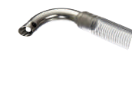
VENOUS CANNULA
Single stage, wire reinforced wall
Round Body Part No. | Oval Body Part No. | Specification
PVC-SS14 RB | PVC-SS14 OB | 14Fr
PVC-SS 16 RB | PVC-SS16 OB | 16Fr
PVC-SS18 RB | PVC-SS18 OB | 18Fr
PVC-SS 20 RB | PVC-SS20 OB | 20Fr
PVC-SS 22 RB | PVC-SS22 OB | 22Fr
PVC-SS 26 RB | PVC-SS26 OB | 26Fr
PVC-SS 26 RB | PVC-SS26 OB | 26Fr
Round Body Part No. | Oval Body Part No. | Specification
PVC-SS 28 RB | PVC-SS28 OB | 28Fr
PVC-SS 30 RB | PVC-SS30 OB | 30Fr
PVC-SS 32 RB | PVC-SS32 OB | 32Fr
PVC-SS 34 RB | PVC-SS34 OB | 34Fr
PVC-SS 36 RB | PVC-SS36 OB | 36Fr
PVC-SS 38 RB | PVC-SS38 OB | 38Fr

Slide 12
Metal Tip Body Part No. | Specification
PVC-SS14 MT | 14Fr
PVC-SS 16 MT | 16Fr
PVC-SS18 MT | 18Fr
PVC-SS 20 MT | 20Fr
PVC-SS 22 MT | 22Fr
PVC-SS 26 MT | 26Fr
PVC-SS 26 MT | 26Fr
Metal Tip Body Part No. | Specification
PVC-SS 28 MT | 28Fr
PVC-SS 30 MT | 30Fr
PVC-SS 32 MT | 32Fr
PVC-SS 34 MT | 34Fr
PVC-SS 36 MT | 36Fr
PVC-SS 38 MT | 38Fr

Slide 13
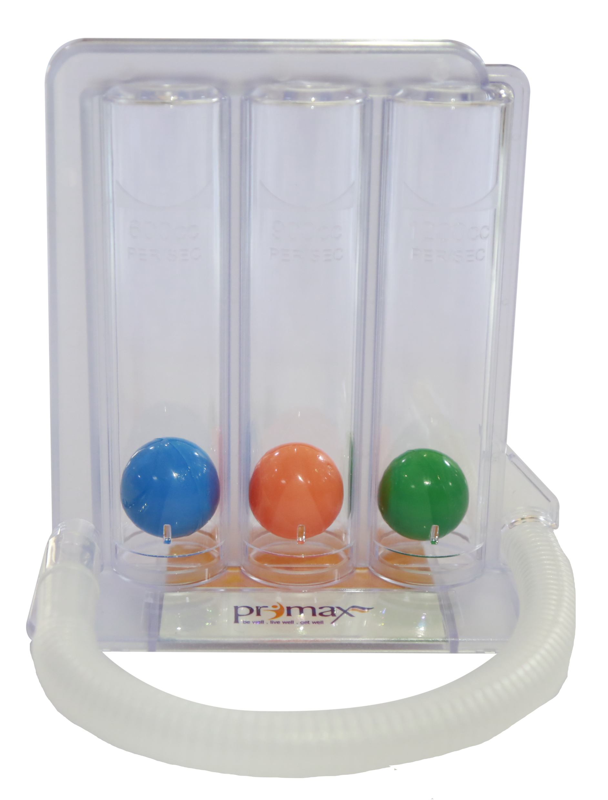
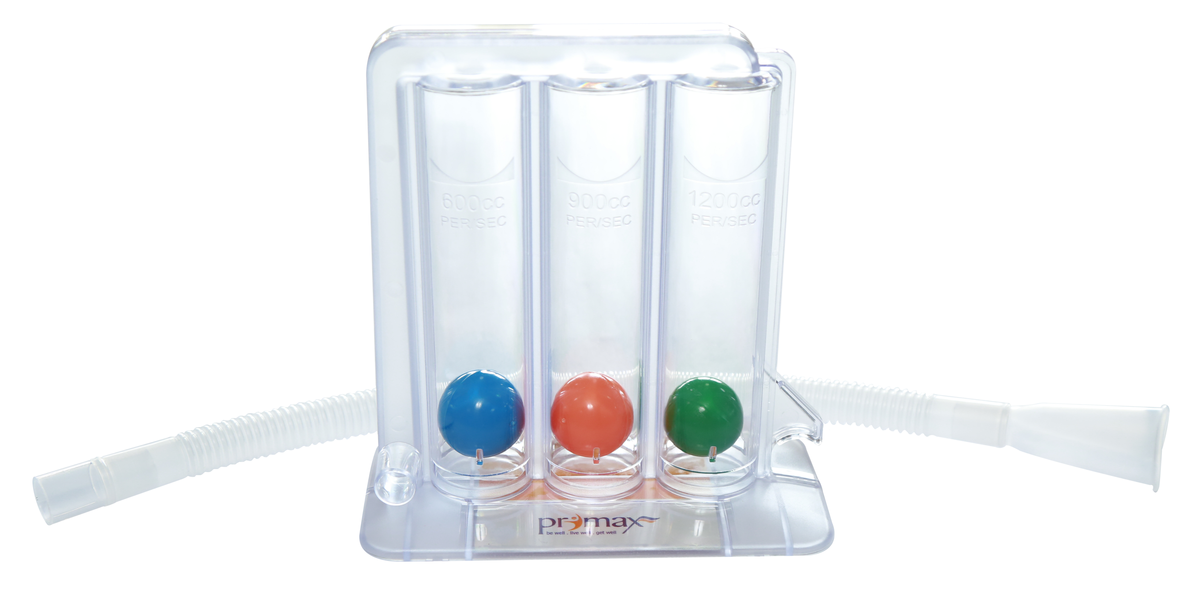
LUNG EXERCISER
Innovative system to exercise respiration through inspiration.
Specially designed with 3 stage chambers to provide more efficient exercise to patient at a step up basis.
Device is composed of base and central part divided into three chambers containing three small spheres of different size and colour.
Three spheres rise proportionately to the inspiration exerted.
Unit Consists of
Transparent main body.
Base
Small spheres of Orange, Purple and Green colour.
Connecting tube with mouth piece.

Slide 14
RIGID SUCTION TUBES
SUCKER ADULT
These suction tubes feature a comfortable hand grip. The tip shaft is made from rigid stainless steel. The Macro Sucker has a fluted pool tip to maximize suction and minimize tissue trauma.
SUCKER PEDIATRIC
The Sucker Pediatric has a soft, vented tip designed to clear blood from the anastomotic site with gentle suction.
Important Safety Information
Care and caution should be taken to avoid damage to vessels and cardiac tissue during cannulation or other cardiac surgery procedures.

Slide 15
ARTERIAL CANNULA
One Piece body, Straight or Curved tip, available with connector acceptance, vented connector or non-vented connector. An adjustable or fixed depth ring together with tip & depth line precise position of all cannula.
Pediatric- 20 cm length
Straight Tip Part No. | Curved Tip Part No. | Specification
PAC-S10 | PAC-C10 | 10Fr
PAC-S12 | PAC-C12 | 12Fr
PAC-S14 | PAC-C14 | 14Fr
PAC-S16 | PAC-C16 | 16Fr
PAC-S18 | PAC-C18 | 18Fr
Adult-20 cm length
PAC-S20 | PAC-C20 | 20Fr
PAC-S22 | PAC-C22 | 22Fr
PAC-S24 | PAC-C24 | 24Fr
PAC-S26 | PAC-C26 | 26Fr

Slide 16
ARTERIAL CANNULA WITH WIRE REINFORCED
One piece and wire reinforced body. Straight or Curved tip, available with connector acceptance, vented connector or non-vented connector
A fixed ring with tip and depth line permits precise position of cannula
Pediatric- 21 cm length
Straight Tip Part No. | Curved Tip Part No. | Specification
PAC-S16 WR | PAC-C16 WR | 16Fr
PAC-S18 WR | PAC-C18 WR | 18Fr
Adult-24 cm length
PAC-S20 WR | PAC-C20 WR | 20Fr
PAC-S22 WR | PAC-C22 WR | 22Fr
PAC-S24 WR | PAC-C24 WR | 24Fr

Slide 17
VENOUS CANNULA
Two stage, wire reinforced wall
Part No. | Specification
Normal Body
PVC-TS32/40 RB | 32/40 Fr
PVC-TS34/46 RB | 34/46 Fr
PVC-TS36/46 RB | 36/46 Fr
PVC-TS36/51 RB | 36/51 Fr

Slide 18
CORONARY ARTERY OSTIAL CANNULA
These cannula feature flanged, radiopaque basket tipes or soft silicon tips attached to large bore. Malleable stainless stell shafts. All cannula have a female Luer connection site.
45° Tip Part No. | 90° Tip Part No. | Specification
PCA-10A45 | PCA-10A90 | 10 Fr
PCA-12A45 | PCA-12A90 | 12 Fr
PCA-14A45 | PCA-14A90 | 14 Fr

Slide 19
Central Venous Catheters
Central Venous Catheter made of specially formulated and biocompatible Polyurethane material provides strength during insertion and also softens at body temperature to conform to the body tissues and reduces the risk and vascular trauma.
Specially designed soft & beveled tip for smooth & easy insertion of catheter
Soft flexible J-Tip Guide wire prevents the vessel perforation and also provides good torque to ensure firm insertion
Sufficiently radio-Opaque material of catheter with clear, definite marking facilitates correct placement of catheter tip
Sterile ready for use
Individually tray packed

Slide 20
Four Lumen
Specially Designed Soft & Conical Tip ensures Atraumatic, Safe & Easy Insertion
Double Lumen
Radiopaque catheter & length markings ensures accurate placement.
Triple Lumen
Biocompatible PU material is stiff & non kinking at room temperature, but softens at body temperature.
Single Lumen
Full range of Adult, Pediatric & Infant CVC Kits are available

Slide 21
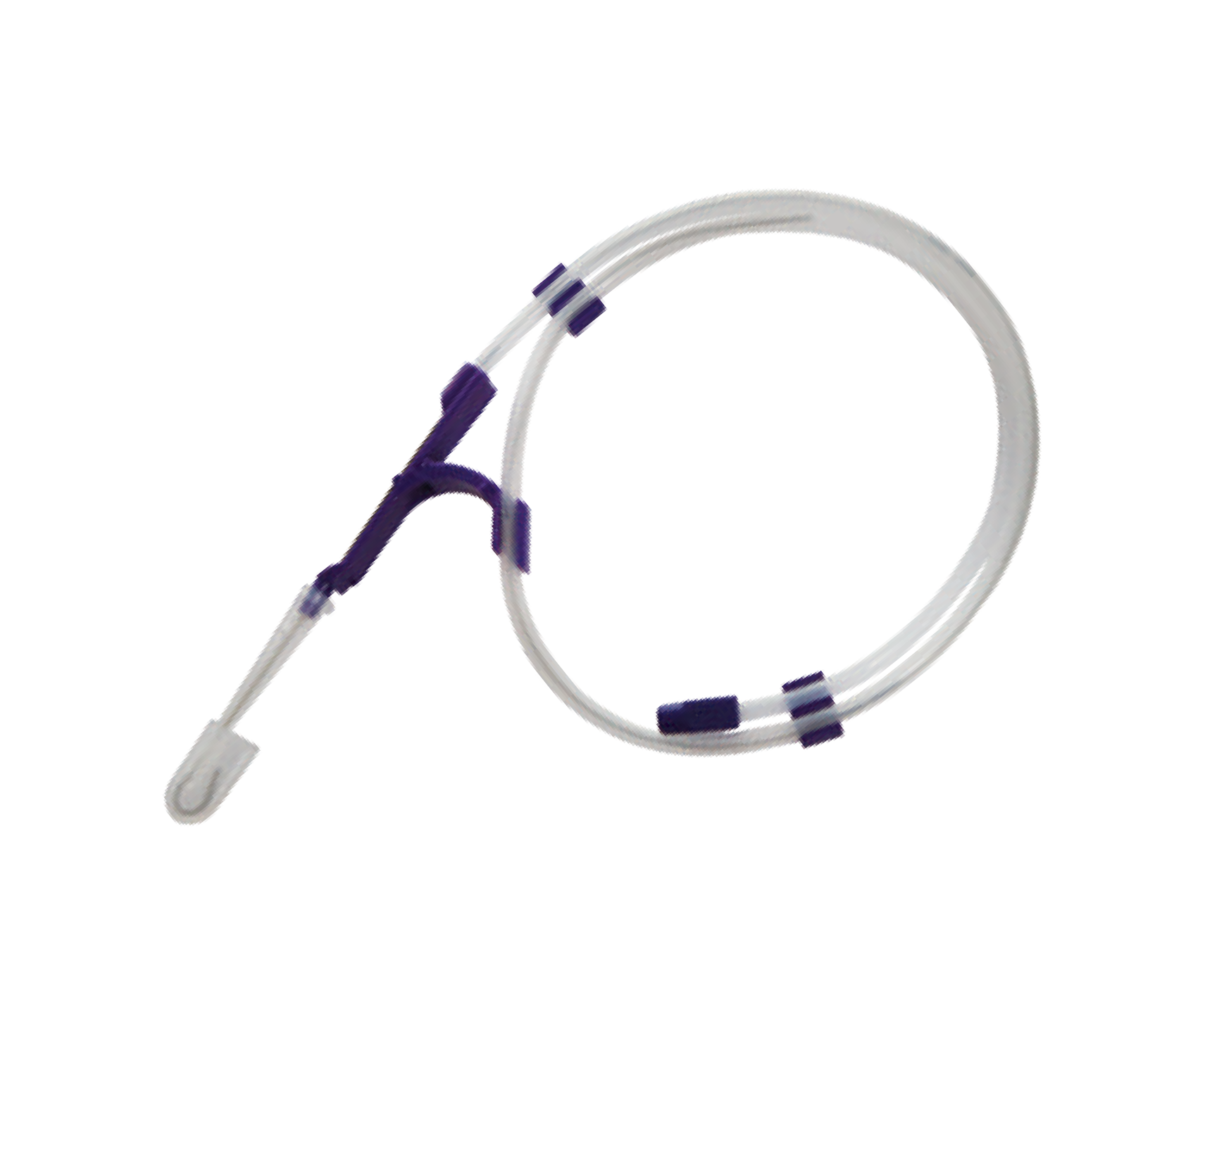
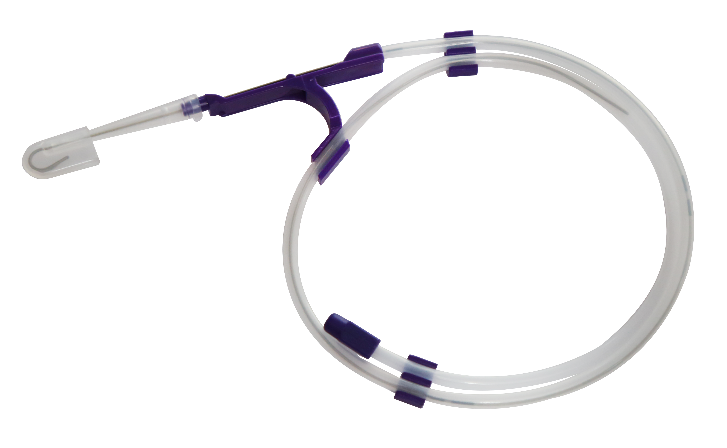
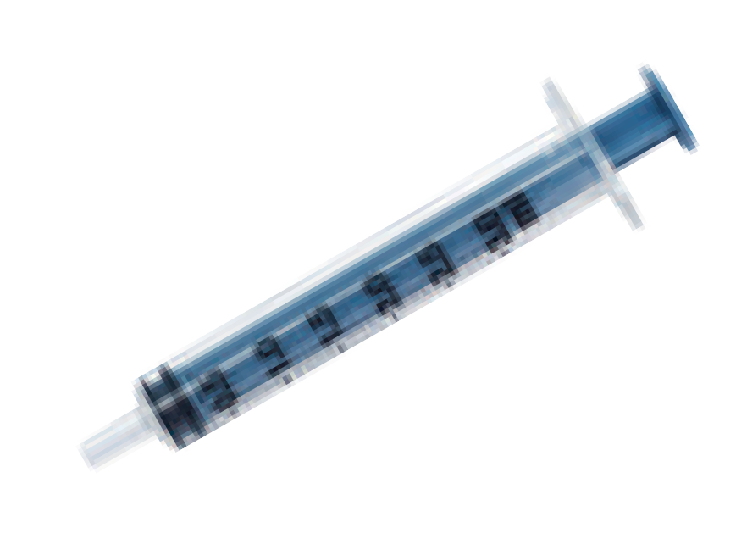
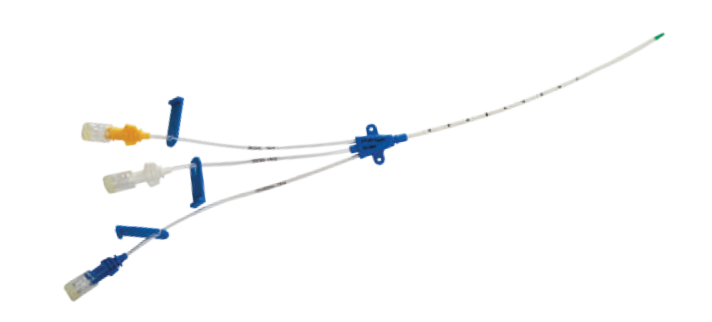
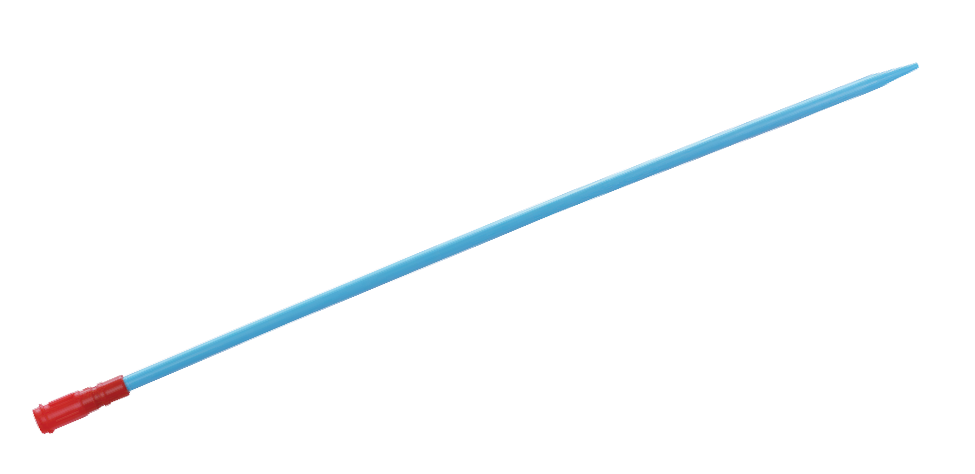
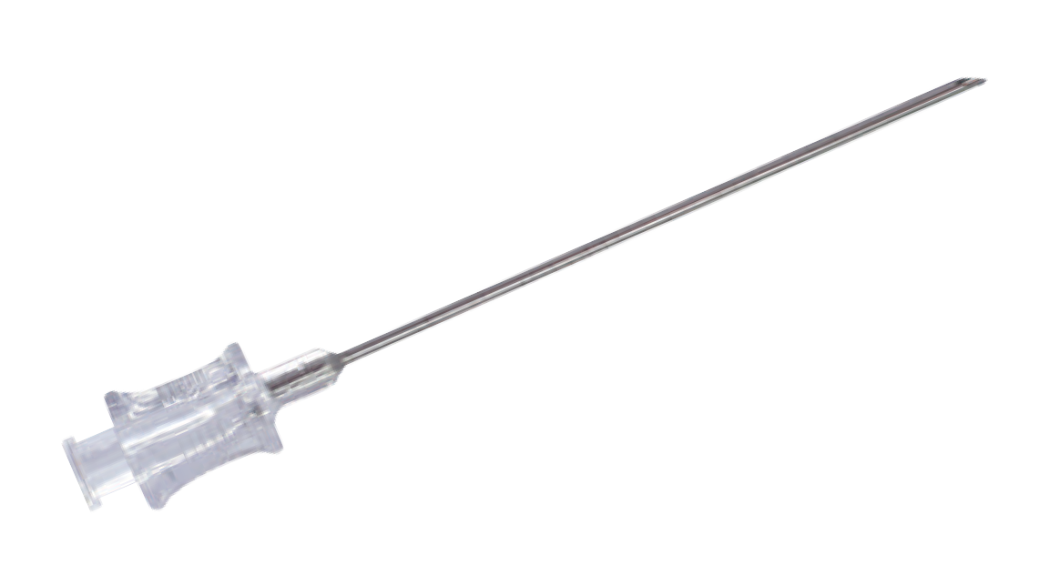
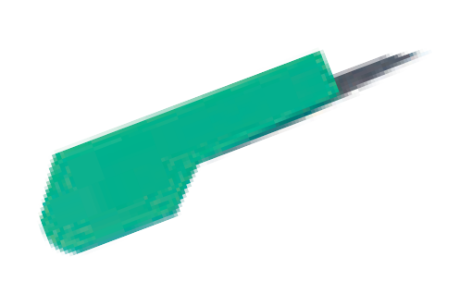
Components
Kink resistant Nickel-Titanium Guidewire with soft & flexible J - tip offers better torque which helps in easy insertion & prevents vessel perforation.
Wires are Double Distal.
2 piece design of guidewire advancer.
CVC kits are available with options of std. Needle, Needle with Back Flow valve & Introducer Syringe
Nickel-Titanium Guidewire

Slide 22
Complete set of CVC kit consist of:
Indwelling catheter
Y-Introducer needle with check valve
J-Tip guide wire
Vessel dilator
Luer lock syrings
Scalpel
Catheter holder
Catheter holder clamp
Injection cap
Extension Line Clamp
Guiding Syringe/LOR Syringe (Optional

Slide 23
Ordering Information:
Particulars | Catheter Size Ga/Fr | Lumen Ga | Gather Length cms | Dilator Fr | Guide Wire Nickle Titanium Double Distal | with Std. Needle | with Y Needle Std. Syringe | with Std. Needle Introducer Syringe
1 Lumen 22Ga 13cms | 22Ga/2Fr | 22 | 13 | 4 | 0.018x50 cm | PCVC-22G01-13 | - | PCVC-22G01-13IS
1 Lumen 20Ga 13cms | 20Ga/3Fr | 20 | 13 | 4 | 0.018x50 cm | PCVC-20G01-13 | - | PCVC-20G01-13IS
1 Lumen 18Ga 20cms | 18Ga/4Fr | 18 | 20 | 5 | 0.018x50 cm | PCVC-18G01-20 | - | PCVC-18G01-20IS
1 Lumen 16Ga 16cms | 16Ga/5Fr | 16 | 16 | 7 | 0.032x60 cm | PCVC-16G01-16 | PCVC-16G01-16YN | PCVC-16G01-16IS
1 Lumen 16Ga 20cms | 16Ga/5Fr | 16 | 20 | 7 | 0.032x60 cm | PCVC-16G01-20 | PCVC-16G01-20YN | PCVC-16G01-20IS
1 Lumen 14Ga 20cms | 14Ga/6Fr | 14 | 20 | 8 | 0.035x50 cm | PCVC-14G01-20 | PCVC-14G01-20YN | PCVC-14G01-20IS

Slide 24
Ordering Information:
Particulars | Catheter Size Ga/Fr | Lumen Ga | Gather Length cms | Dilator Fr | Guide Wire Nickle Titanium Double Distal | with Std. Needle | with Y Needle Std. Syringe | with Std. Needle Introducer Syringe
2 Lumen 4Fr 6cms | 4Fr | 20,22 | 6 | 5 | 0.018x50 cm | PCVC-402-6 | - | PCVC-402-6IS
2 Lumen 4Fr 8cms | 4Fr | 20,22 | 8 | 5 | 0.018x50 cm | PCVC-402-8 | - | PCVC-402-8IS
2 Lumen 4Fr 13cms | 4Fr | 20,22 | 13 | 5 | 0.018x50 cm | PCVC-402-13 | - | PCVC-402-13IS
2 Lumen 5Fr 8cms | 5Fr | 18,20 | 8 | 6 | 0.018x50 cm | PCVC-502-8 | - | PCVC-502-8IS
2 Lumen 5Fr 13cms | 5Fr | 18,20 | 13 | 6 | 0.018x50 cm | PCVC-502-13 | - | PCVC-502-13IS
2 Lumen 7Fr 16cms | 7Fr | 14, 18 | 16 | 8 | 0.035x 50 cm | PCVC-702-16 | PCVC-702-16YN | PCVC-702-16IS
2 Lumen 7Fr 20cms | 7Fr | 14, 18 | 20 | 8 | 0.035x 60 cm | PCVC-702-20 | PCVC-702-20YN | PCVC-702-20IS

Slide 25
Ordering Information:
Particulars | Catheter Size Ga/Fr | Lumen Ga | Gather Length cms | Dilator Fr | Guide Wire Nickle Titanium Double Distal | with Std. Needle | with Y Needle Std. Syringe | with Std. Needle Introducer Syringe
3 Lumen 4.5Fr 6cms | 4.5 Fr | 20,22,22 | 6 | 5 | 0.018x50 cm | PCVC-4.503-6 | - | PCVC-4.503-6IS
3 Lumen 4.5Fr 10cms | 4.5 Fr | 20,22,22 | 10 | 5 | 0.018x50 cm | PCVC-4.503-10 | - | PCVC-4.503-10IS
3 Lumen 5.5Fr 6cms | 5.5 Fr | 20,22,22 | 6 | 6 | 0.018x50 cm | PCVC-5.503-6 | - | PCVC-5.503-6IS
3 Lumen 5.5Fr 8cms | 5.5 Fr | 20,22,22 | 8 | 6 | 0.018x50 cm | PCVC-5.503-8 | - | PCVC-5.503-8IS
3 Lumen 5.5Fr 13cms | 5.5 Fr | 20,22,22 | 13 | 6 | 0.018x50 cm | PCVC-5.503-13 | - | PCVC-5.503-13IS
3 Lumen 7Fr 10cms | 7Fr | 16,18, 18 | 10 | 8 | 0.035x 50 cm | PCVC-703-10 | PCVC-703-10YN | PCVC-703-10IS
3 Lumen 7Fr 13cms | 7Fr | 16,18, 18 | 13 | 8 | 0.035x 50 cm | PCVC-703-13 | PCVC-703-13YN | PCVC-703-13IS

Slide 26
Ordering Information:
Particulars | Catheter Size Ga/Fr | Lumen Ga | Gather Length cms | Dilator Fr | Guide Wire Nickle Titanium Double Distal | with Std. Needle | with Y Needle Std. Syringe | with Std. Needle Introducer Syringe
3 Lumen 7Fr 16cms | 7Fr | 16,18, 18 | 16 | 8 | 0.035x 50 cm | PCVC-703-16 | PCVC-703-16YN | PCVC-703-16IS
3 Lumen 7Fr 20cms | 7Fr | 16,18, 18 | 20 | 8 | 0.035x 60 cm | PCVC-703-20 | PCVC-703-20YN | PCVC-703-20IS
4 Lumen 8.5Fr 10cms | 8.5 Fr | 14,16,18,18 | 10 | 9 | 0.035x 50 cm | PCVC-8.504-10 | PCVC-8.504-10YN | PCVC-8.504-10IS
4 Lumen 8.5Fr 13cms | 8.5 Fr | 14,16,18,18 | 10 | 9 | 0.035x 50 cm | PCVC-8.504-13 | PCVC-8.504-13YN | PCVC-8.504-13IS
4 Lumen 8.5Fr 16cms | 8.5 Fr | 14,16,18,18 | 16 | 9 | 0.035x 50 cm | PCVC-8.504-16 | PCVC-8.504-16YN | PCVC-8.504-16IS
4 Lumen 8.5Fr 20cms | 8.5 Fr | 14,16,18,18 | 20 | 9 | 0.035x 60 cm | PCVC-8.504-20 | PCVC-8.504-20YN | PCVC-8.504-20IS

Slide 27
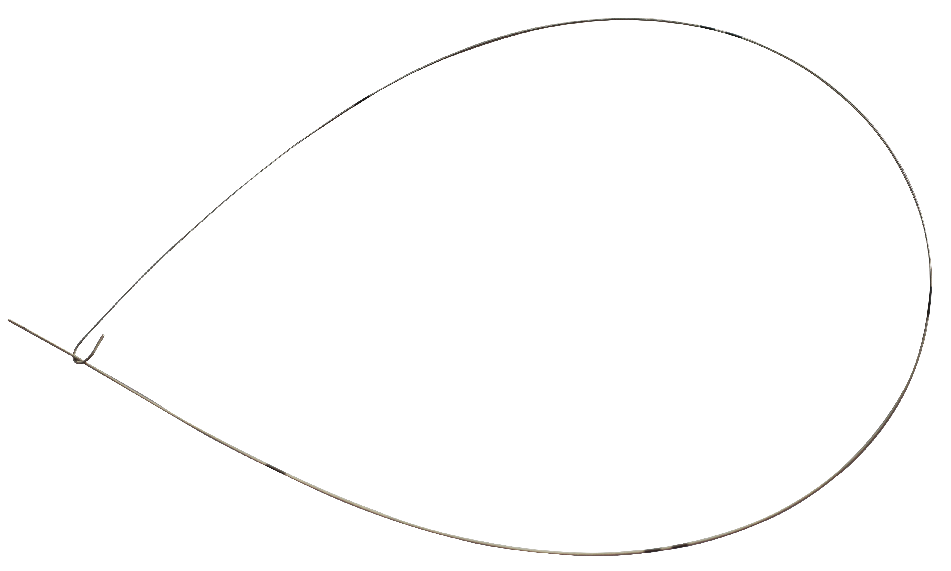
Arterial Catheter kit

Slide 28
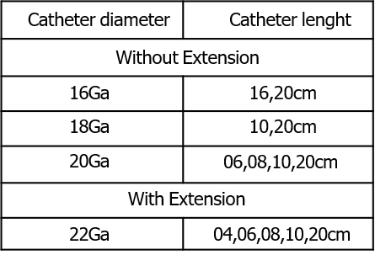
Arterial Catheter kit
Application
Specification
Monitor invasive arterial blood pressure Collect blood sample
Infusion drug and solution
Characteristics
The tube is good biocompatibility and it is convenient for catheter placement due to stiff catheter. Standard Seldinger Technique
Catheter and guidewire are protected by sheath Nitinol guidewire is available
Straight introducer needle configuration is available
NOTE : Sizes are available with or without extension
Set contents:
Catheter for radial arterial pressure monitoring
Prymax Arterial Catheter is a semi transparent, x-ray visible catheter made of pressureresistant polyethylene that delivers constant pressure transmission even for extended dwell times.
Catheter
Naturally echogenic needle
Safety guidewire with a straight, flexible tip
The catheter and insertion needle have the same diameter, meaning that catheter placement is largely atraumatic.

