Slide 1
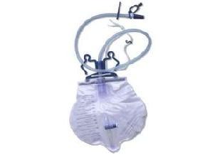
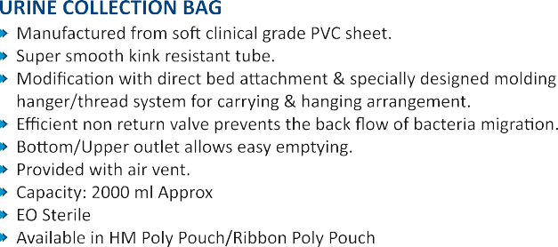

Slide 2
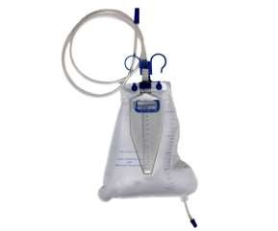

Slide 3
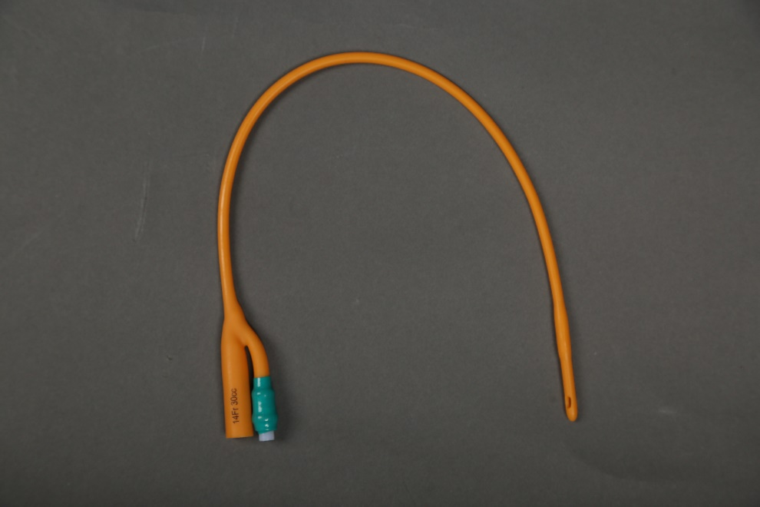
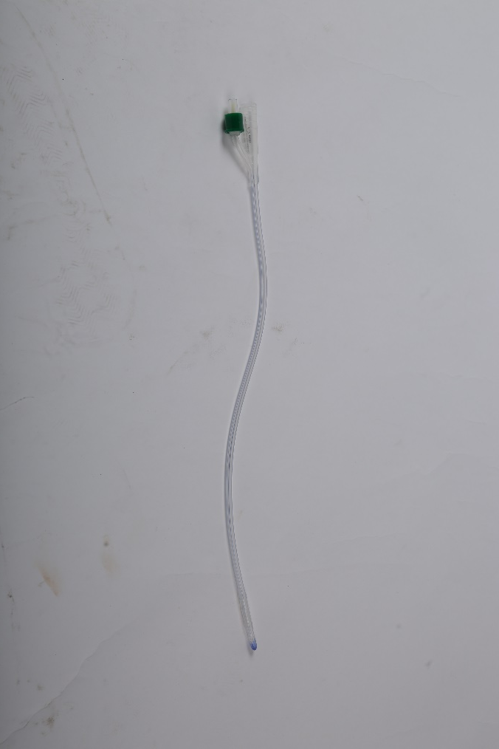
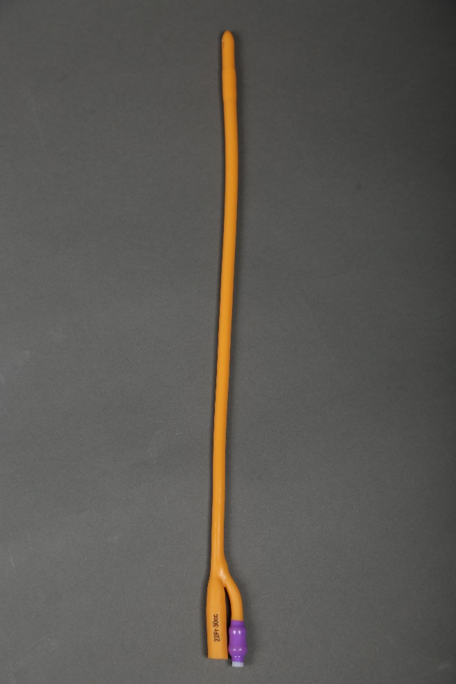
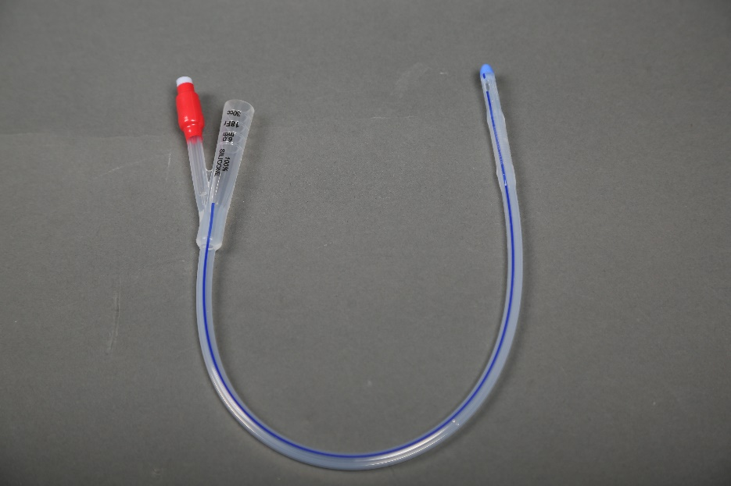

Slide 4
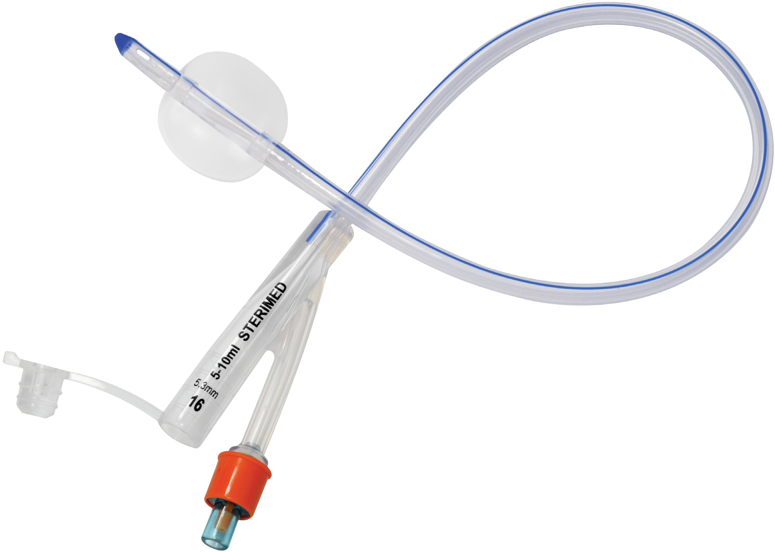
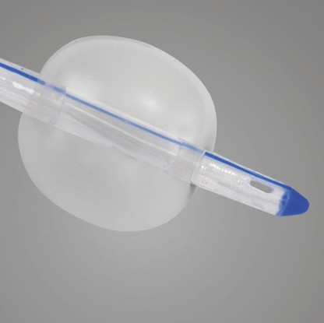
Silicon Foley Balloon Catheter
High elastic tear resistant balloon
Provided with flow control clamp to ensure proper use of bladder muscles .
Self lubricated silicon shaft provides low friction surface to allow trauma free removal.
Balloon made from low durometer, highly elastic silicon which provides very good tear strength.
TWO WAY |  | THREE WAY
Size in FR | Balloon Capacity | Size in FR | Balloon Capacity
6 | 3cc | 16,18, 20, 22, 24 & 26 | 30cc - 50cc
8 -10 | 3cc - 5cc
12 - 14 | 5cc - 15cc
16 - 26 | 30cc - 50cc
SIZES
FR | 8 | 10 | 12 | 14 | 16 | 18 | 20 | 22 | 24 | 26
Colour Code | Black | Grey | White | Green | Orange | Red | Yellow | Voilet | Blue | Pink

Slide 5
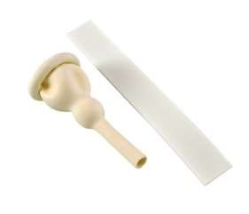

Slide 6
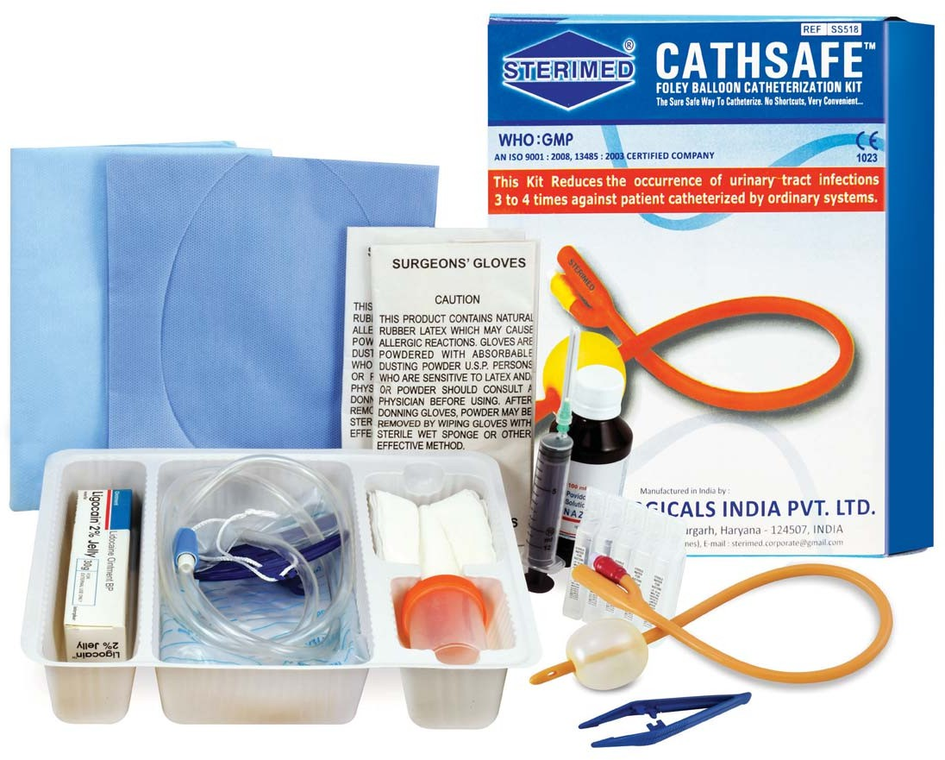
Cathsafe
s Complete solution for the indwelling catheterization process
s Easy to use, store and transport
s Increases efficiency for medical practitioners
List of contents:
s Foley Balloon Catheter
s Syringe
s Gauze Swab 7.5cmx7.5cmx12 ply
s Urine Culture Bottle 30 ml
s Plastic forceps
s Drape sheet with rhomboid hole
s Water Proof drape
s Latex Gloves 2 pair
Optional:
s Urine Bag
s Povidone
s Lignocaine Gel
s Sterile Water

Slide 7
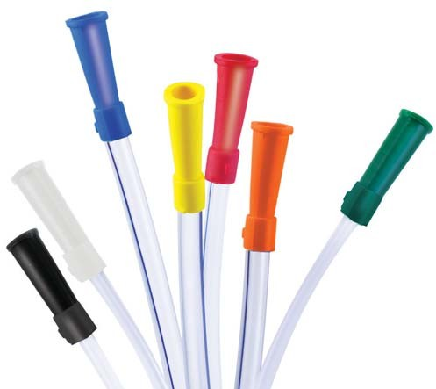
Urethral Catheter
s Used for short term bladder catheterization
s Made from non-toxic, non-irritant, medical grade PVC
s Radio opaque line provided through out the catheter for X-ray visualization
s Distal end with lateral eyes and proximal end funnel connector, for maximum drainage and easy connection to the urine bag
VERSION | EFFECTIVE LENGTH | TOTAL LENGTH
Male | 370mm | 400mm
Female | 170mm | 200mm
SIZES
FG | 6 | 8 | 10 | 12 | 14 | 16 | 18 | 20
Colour Code | Light Green | Blue | Black | White | Green | Oragne | Red | Yellow

Slide 8
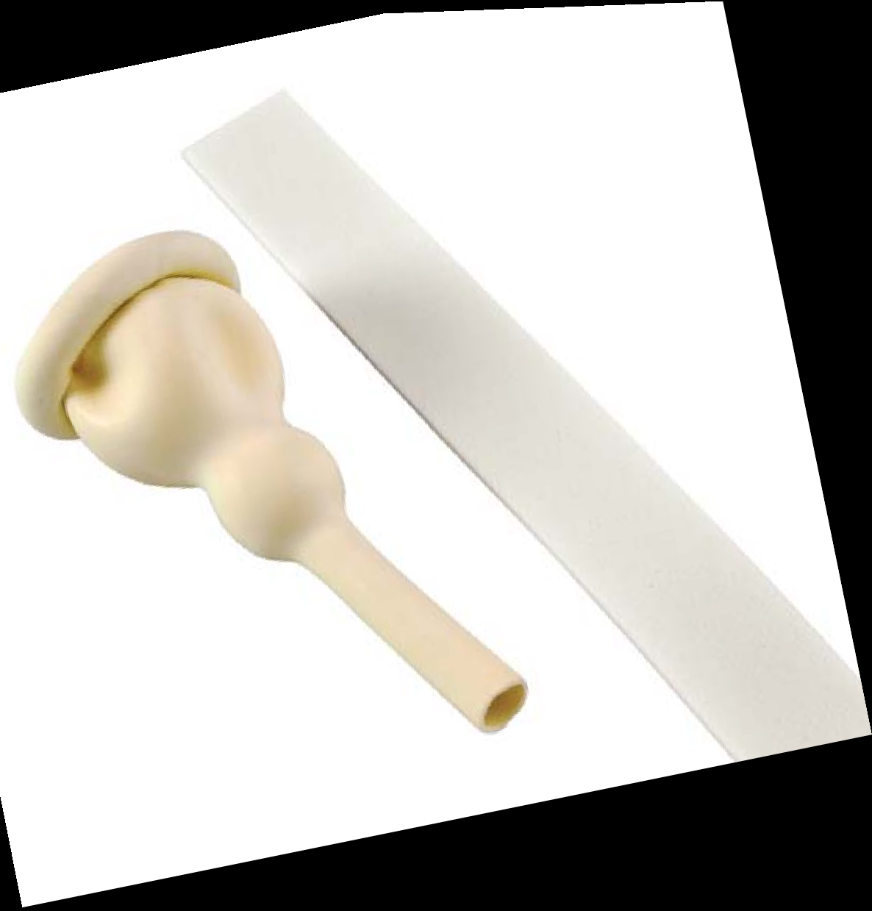
Male External Catheter
s Used for urine drainage in incontinent male patients
s Made from natural latex rubber
s Provided with adhesive strip for proper fixing of the catheter
SIZES
Small | 20mm
Medium | 25mm
Large | 30mm
Extra Large | 35mm

